Slide 1

Customer Churn Prediction
Sigmoid Case Study
Abhishek Srivastava

Slide 2

Quick Slide Reference
Slide 3-6
Slide 7-12
Correlation analysis; Significance test; Multicollinearity & Imputation
Slides 13-19
Pre-modeling steps; Algorithms; Model Evaluation & Prescriptive analysis
Slides 20-23
Annexure
Problem statement; Dataset, Data cleaning & Assumption

Slide 3



Problem Statement & Business Objective
Problem
Predict the customer churn and its impact on business revenue
Objective
Develop a predictive model that can identify customers who are likely to churn.
KPI
Model accuracy
Customer churn rate.
Revenue growth.

Slide 4
Data Overview
Total Records
50,000
Total Features: 230
Customer Churn Labels:
38 categorical
174 numerical
18 Null
1 → Churned (majority class)
-1 → Not Churned (Minority class; 7% of total records)

Slide 5
Assumptions
The case study focuses on predicting customer churn, with the labels 1 and -1 in the train_churn_labels.xls file representing customers who have historically churned and those who have not, respectively.
I believe that the missing values in the data are not a result of data collection issues, but rather reflect the information provided by the client.
I posit that the columns containing discrete integer values in the dataset should be classified as numerical features rather than encoded categorical features.

Slide 6
Data Cleaning
After removing 136 columns with more than 90% Null values.
76 (34 cat. & 42 num.) cols
Features after removal of blank columns
212 (38 cat. & 174 num.) columns
230 (38 cat.; 174 num. &18 Null) columns
Total Features in the data

Slide 7
Significance Test: 42 Numerical Variables
Statistically significant num features & significant correlation with o/p variable
26 i/p Vars.
p < 0.05
correlation ≠ 0
1
Vars: 126,113,81,28,149,153,143, 76,173,119,85,25,24,160,125,94,6, 74,140,72,65,13,144,73,7,189
Significant num features but very low or close to 0 correlation with o/p variable
3 i/p Vars.
p < 0.05
correlation ≈ 0
2
Vars: 32, 22,& 21
13 i/p Vars.
p ≥ 0.05
Vars: 38,132,134,163,133,78, 181,83,123,44,57,109, & 112
3
Statistically insignificant numerical features.
*See Annexture-I for complete list of correlation & p-values for 42 numerical variables.

Slide 8
Significance Test: 34 Categorical Variables
19 i/p Vars.
p < 0.05
1
Statistically significant categorical features
Vars: 195,197,225,216,204,211, 226,221,218,207,210,227,193, 212,228,206,205,192, & 199.
Vars: 217,198,220,222,202, 229,201,194,200,214,223,196, 219,208, & 203.
15 i/p Vars.
p ≥ 0.05
2
Statistically insignificant categorical features.
*See Annexture-II for complete list of p-values for 34 categorical variables.

Slide 9
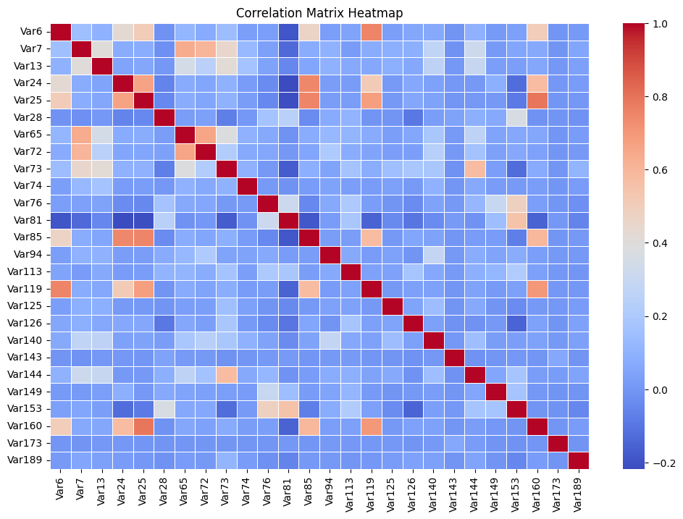
Multicollinearity
Num Variables Correlation Matrix* Heatmap
Observations:
Var24 & Var25 show strong correlation with each other and with Var85, Var119 & Var160.
Var24 & Var25 show moderate correlation with Var6.
Var65 & Var72 show strong correlation with each other and with Var7.
Var85 shows good correlation with Var119 & 160. It also shows moderate correlation with Var6.
Var119 shows correlation with Var6, Var85 & Var160.
Action:
Var24, Var25, Var65, Var72, Var85, & Var119 input features removed to avoid multicollinearity.
*Imputed NULL with mean values to check multicollinearity.

Slide 10
Feature with more than 15% NULL Values
Var Type | Numerical Variables |  |  | Cat Variable
Var Name | Var189 | Var94 | Var126 | Var225
Null % | 57.9% | 44.7% | 27.8% | 52.2%
Correlation Value | -0.11 | -0.015 | 0.054 | --
Chi-square | -- | -- | -- | 18.198
Numerical Variables:
Drop Var94 because the correlation (-0.015) is very weak.
Impute Var189 & Var126 using a suitable method:
If the data is normally distributed, use mean imputation.
For Var 126, KNN Imputation can be used. Median can also be used if computational cost is high.
KNN or Predictive Imputation as Var 189 has the strongest correlation with output variable.
Categorical Variable:
Var225 has a high Chi-Square, it's significant and should not be dropped.
Imputation options:
Fill missing values with the most frequent category (mode).
Introduce a new category called "Missing“ as the Var225 has only 3 unique values.

Slide 11
Remaining Numerical Variable Imputation
Numerical Var | Null% | Imputation | Reason
 | 10-15% | Median Imputation | For moderate missing values (≤ 15%), since it is robust against outliers.
 | 10-11% | Drop | Low correlation & not highly significant.
 | 10.02% | Drop | Low correlation & not highly significant. Also, the variance is very low.
Var125 | Var149
Var13 | Var6
Var140 | Var7
Var144 | Var81
Var74 | Var28
Var153 | Var160
Var76
Var143 | Var173

Slide 12
Remaining Categorical Variable Imputation
Categorical Var | Unique Values | Null% | Imputation | Reason
Var218 | 2 | 1.41% | Mode Imputation | Both variables have very few unique values, the most frequent category (mode) is the best option.
Var205 | 3 | 3.87%
Var199 | 5073 | 0.008% |  | Very few missing values & high cardinality, so mode imputation will not introduce bias.
Var206 | 21 | 11.06% | Add ‘Missing Category’ | Var206 has 21 categories, so mode imputation may not be ideal. Var192 & Var197 have high cardinality, so mode imputation may distort distributions. Adding a new "Missing" category keeps all data without introducing bias.
Var192 | 361 | 0.74%
Var197 | 225 | 0.29%

Slide 13
Pre-Model Building Steps
Encoding Categorical Variables
1
Use One-Hot, Ordinal, Binary or Frequency Encoding based on cardinality.
2
Scaling
Essential step as data has features with different scales. Use standard, min-max, Log transform scaling based on distribution.
3
Feature Engineering
It helps capture customer behavior & domain-specific insights, like recency, monetary & frequency; High-value/ inactive customers;
4
Class Imbalance
Essential for a robust churn prediction model. Use over/under or hybrid sampling or algorithm-level methods (class weights)

Slide 14
Algorithms for Model Building
Suitable algorithms for churn prediction (binary classification) which can handle a mix features & imbalanced data with 50k records.
1
2
3
LightGBM
Good for mixed data types.
Fast & Scalable.
Efficient with missing values.
Efficient missing data handling.
Great feature importance analysis.
Memory efficient.
CatBoost
Built-in Categorical Handling: No need to convert cat. Variables.
For high-cardinal features, performs better than LightGBM.
Less Hyperparameter Tuning
Naturally deal with missing values.
XGBoost
Highly Accurate: top performing for churn prediction.
Robust to Class Imbalance.
Performs Well with Non-Linear Relationships
Great feature Importance & Interpretability:.
*See Annexture-III for complete list of 31 input variables.

Slide 15
Model Evaluation Metrics
Primary Metrics
F1 Score
AUC:ROC
Secondary Metrics
Precision
Recall
Accuracy
Interpretability
Understand the overall behavior of the model at global & local level.

Slide 16
Model Evaluation Metrics
Primary Metrics
F1 Score
AUC:ROC
F1-Score:
The harmonic mean of precision and recall.
Ideal for imbalanced datasets (like churn analysis) because it balances the trade-off between precision and recall.
AUC-ROC:
Measures the model's ability to distinguish between churned and non-churned customers.
Useful for evaluating the overall performance of the model

Slide 17
Model Evaluation Metrics
Secondary Metrics
Precision
Recall
Accuracy
Precision:
Recall:
Measures how many actual churners are correctly identified. Important when missing a churner (False Negative) is costly
Measures how many predicted churners are correct. Important when marketing budget is limited (avoid wasting on non-churners)

Slide 18
Model Evaluation Metrics
Interpretability
Understand the overall behavior of the model at global & local level.
Global Interpretability:
Local Interpretability:
Explains predictions by evaluating contributions of features to a single prediction. Use SHAP (Shapley Values) for single instances.
Explain complex models to check distribution of feature importance & effects. Use SHAP (Shapley Additive Explanations) Summary Plot.

Slide 19
Prescriptive Analysis post ML Model Prediction
Segment Customers Based on Churn Risk. For drop-in, Immediate intervention for high-risk customers.
Identify Key Churn Drivers like high charges, poor customer support and so on.
Recommend Actions for Each Segment. For instance, offer high discount to high-risk customers with high charges.
Monitor retention strategies by checking drop-in churn rate after implementing action recommended for high churn risk customers.

Slide 20

Annexure

Slide 21
Annexure-I
42 Numerical Variables Correlation & p-values
Num Variable | Correlation | p-Value
Var126 | 0.054156 | 0
Var113 | 0.053845 | 0
Var81 | 0.038462 | 0
Var28 | 0.017132 | 0.000279
Var149 | 0.013916 | 0.004001
Var153 | 0.010934 | 0.020385
Var143 | 0.010795 | 0.022036
Var76 | 0.010722 | 0.022949
Var173 | 0.01043 | 0.026942
Var119 | -0.010475 | 0.027173
Var85 | -0.011574 | 0.01409
Var25 | -0.012117 | 0.010164
Var24 | -0.013221 | 0.00625
Num Variable | Correlation | p-Value
Var160 | -0.013672 | 0.003731
Var125 | -0.015529 | 0.001059
Var94 | -0.015748 | 0.008865
Var6 | -0.017279 | 0.000268
Var74 | -0.017722 | 0.000186
Var140 | -0.028228 | 0
Var72 | -0.039718 | 0
Var65 | -0.0398 | 0
Var13 | -0.042526 | 0
Var144 | -0.051613 | 0
Var73 | -0.067534 | 0
Var7 | -0.068928 | 0
Var189 | -0.118639 | 0
Num Variable | Correlation | p-Value
Var38 | 0.008455 | 0.072927
Var132 | 0.007636 | 0.10529
Var134 | 0.005483 | 0.244821
Var163 | 0.003197 | 0.497769
Var133 | 0.002755 | 0.55896
Var78 | 0.00274 | 0.561067
Var181 | 0.000989 | 0.833807
Var83 | -0.00011 | 0.981372
Var123 | -0.000405 | 0.93156
Var44 | -0.001674 | 0.722556
Var57 | -0.006577 | 0.141361
Var109 | -0.007995 | 0.098245
Var112 | -0.008566 | 0.069225
Num Variable | Correlation | p-Value
Var35 | 0.0095 | 0.043903
Var22 | -0.009296 | 0.048635
Var21 | -0.009467 | 0.045881

Slide 22
Annexure-II
34 Categorical Variables p-values
Cat Variable | Chi-square | p-Value
Var195 | 48.414975 | 9.56E-04
Var197 | 300.351999 | 4.93E-04
Var225 | 18.198237 | 1.12E-04
Var216 | 2411.646543 | 1.93E-09
Var204 | 222.952165 | 1.51E-11
Var211 | 46.294381 | 1.02E-11
Var226 | 114.545608 | 1.69E-14
Var221 | 108.400264 | 4.41E-21
Var218 | 92.419119 | 7.01E-22
Var207 | 157.932822 | 5.16E-27
Var210 | 134.834686 | 2.24E-27
Var227 | 140.407508 | 8.22E-28
Var193 | 246.905893 | 7.61E-28
Var212 | 350.653649 | 1.46E-35
Var228 | 267.895274 | 1.67E-40
Var206 | 266.914235 | 4.35E-45
Var205 | 261.391051 | 1.74E-57
Var192 | 1122.776986 | 2.68E-79
Var199 | 7777.220996 | 3.43E-119
Cat Variable | Chi-square | p-Value
Var217 | 12472.76257 | 1.00E+00
Var198 | 3854.359221 | 1.00E+00
Var220 | 3854.359221 | 1.00E+00
Var222 | 3854.359221 | 1.00E+00
Var202 | 5435.681978 | 9.96E-01
Var229 | 0.593504 | 8.98E-01
Var201 | 0.03479 | 8.52E-01
Var194 | 0.352299 | 8.38E-01
Var200 | 15417.21665 | 4.91E-01
Var214 | 15417.21665 | 4.91E-01
Var223 | 2.682889 | 4.43E-01
Var196 | 5.299798 | 1.51E-01
Var219 | 28.063907 | 1.38E-01
Var208 | 2.914474 | 8.78E-02
Var203 | 8.328348 | 8.03E-02

Slide 23
Annexure-III
31 Features used for churn prediction model
Numerical Var | Non-Null Values
Var6 | 44471
Var7 | 44461
Var13 | 44461
Var73 | 50000
Var81 | 44471
Var113 | 50000
Var125 | 44461
Var126 | 36080
Var140 | 44461
Var144 | 44471
Var149 | 42770
Var189 | 21022
Categorical Var | Non-Null Values
Var192 | 49631
Var193 | 50000
Var195 | 50000
Var197 | 49857
Var199 | 49996
Var204 | 50000
Var205 | 48066
Var206 | 44471
Var207 | 50000
Var210 | 50000
Categorical Var | Non-Null Values
Var211 | 50000
Var212 | 50000
Var216 | 50000
Var218 | 49297
Var221 | 50000
Var225 | 23856
Var226 | 50000
Var227 | 50000
Var228 | 50000

Slide 24


